Slide 1
BERT (Bidirectional Transformers for Language Understanding)

Slide 2
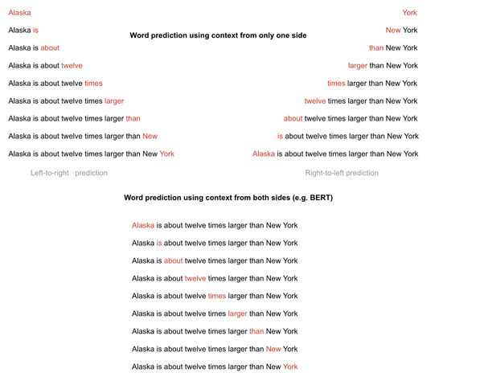
BERT trains language model in both directions

Slide 3
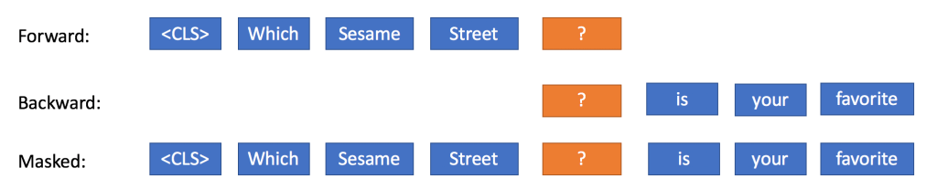
BERT trains Language Model in both directions

Slide 4
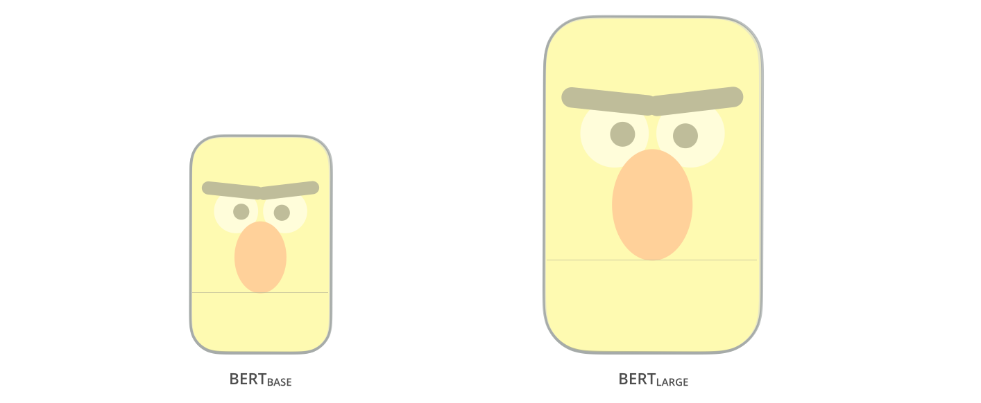
BERT

Slide 5
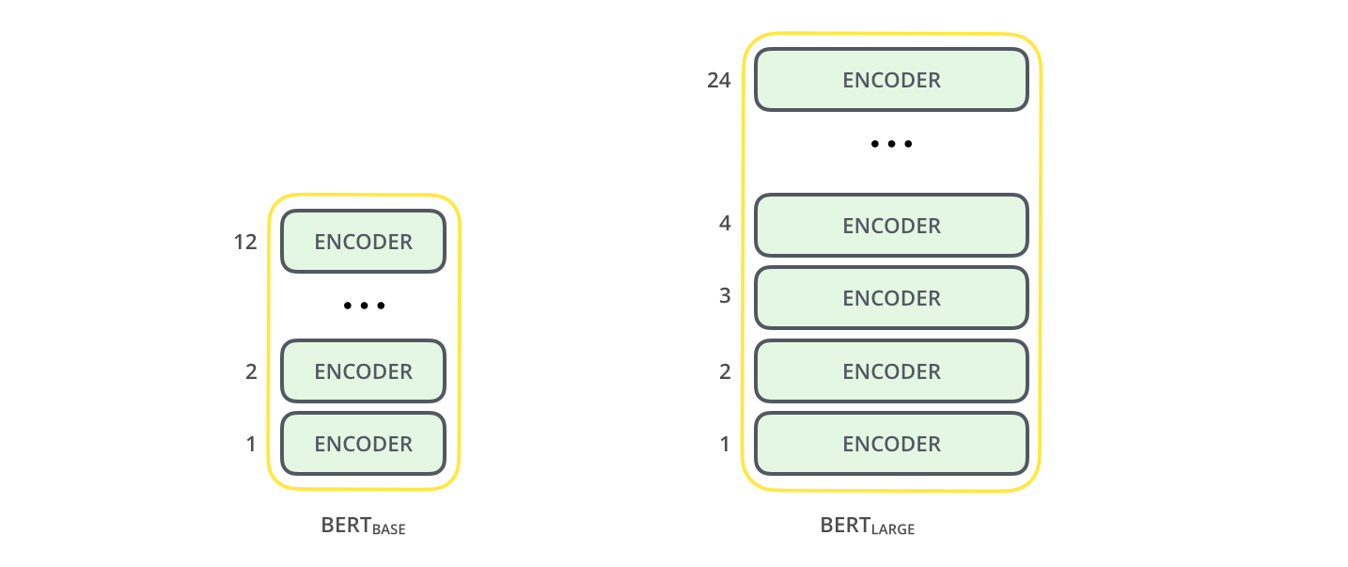
BERT: Only Encoders are used
These also have larger feedforward-networks (768 and 1024 hidden units respectively), and more attention heads (12 and 16 respectively)

Slide 6
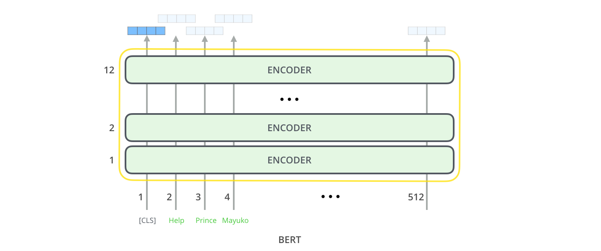
BERT: Only Encoders are used

Slide 7
BERT: For Language Modeling
Use [MASK] token for 15% for text
In this 15% tokens, 80% will be replaced with ‘[MASK]’, 10% will be replaced with a random word from vocabulary, 10% will not be replaced.

Slide 8
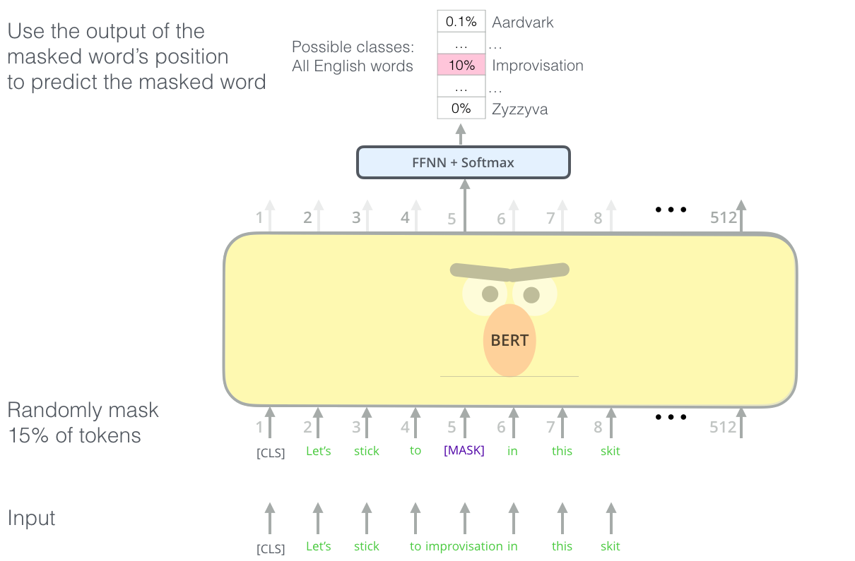
language modeling: Use [MASK] token for 15% for text

Slide 9
All 15% are not MASKED
80% were replaced by the ‘<MASK>’ token
Example: “My dog is <MASK>”
10% were replaced by a random token
Example: “My dog is apple”
10% were left intact
Example: “My dog is hairy”

Slide 10
Why did they not use a ‘<MASK>’ replacement token all around?

Slide 11
If the model had been trained on only predicting ‘<MASK>’ tokens and then never saw this token during fine-tuning, it would have thought that there was no need to predict anything and this would have hampered performance
By sometimes asking it to predict a word in a position that did not have a ‘<MASK>’ token, the model needed to learn a contextual representation of all the words in the input sentence, just in case it was asked to predict them afterwards.

Slide 12
Are not random tokens enough? Why did they leave some sentences intact?
Ideally we want the model’s representation of the masked token to be better than random. By sometimes keeping the sentence intact (while still asking the model to predict the chosen token) the authors biased the model to learn a meaningful representation of the masked tokens.

Slide 13
Will random tokens confuse the model?
The random replacement happened in 1.5% of the tokens (10%*15%) and the authors claim that it did not affect the model’s performance.

Slide 14
The model will only predict 15% of the tokens but language models predict 100% of tokens, does this mean that the model needs more iterations to achieve the same loss?
Training will be slower as model only predicts 15% of words

Slide 15
language modeling: Use [MASK] token for 15% for text

Slide 16
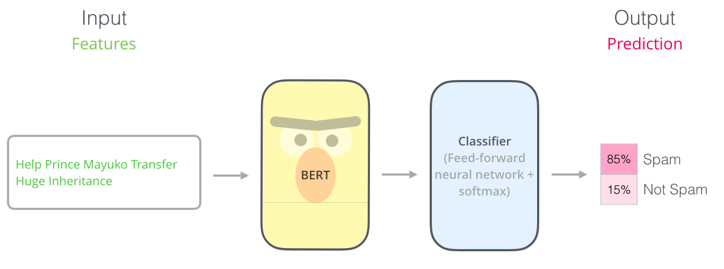
BERT: Sentence Classification

Slide 17
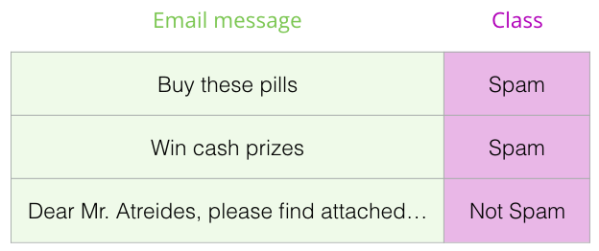
BERT: Sentence Classification

Slide 18
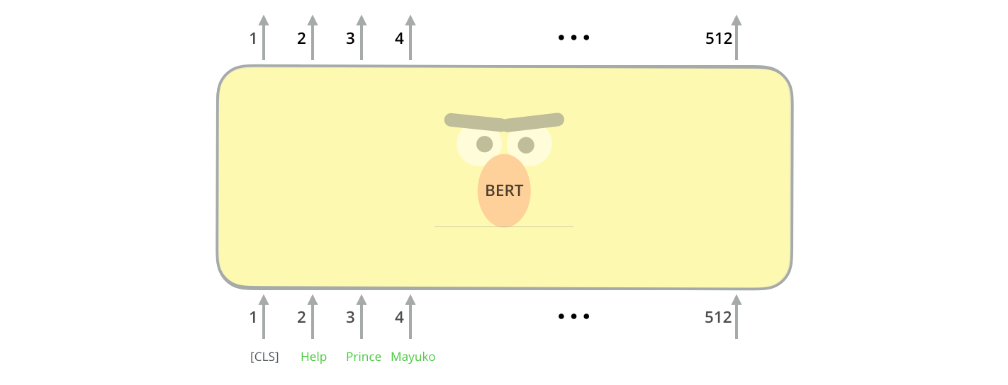
BERT: A special [CLS] token is used for classification

Slide 19
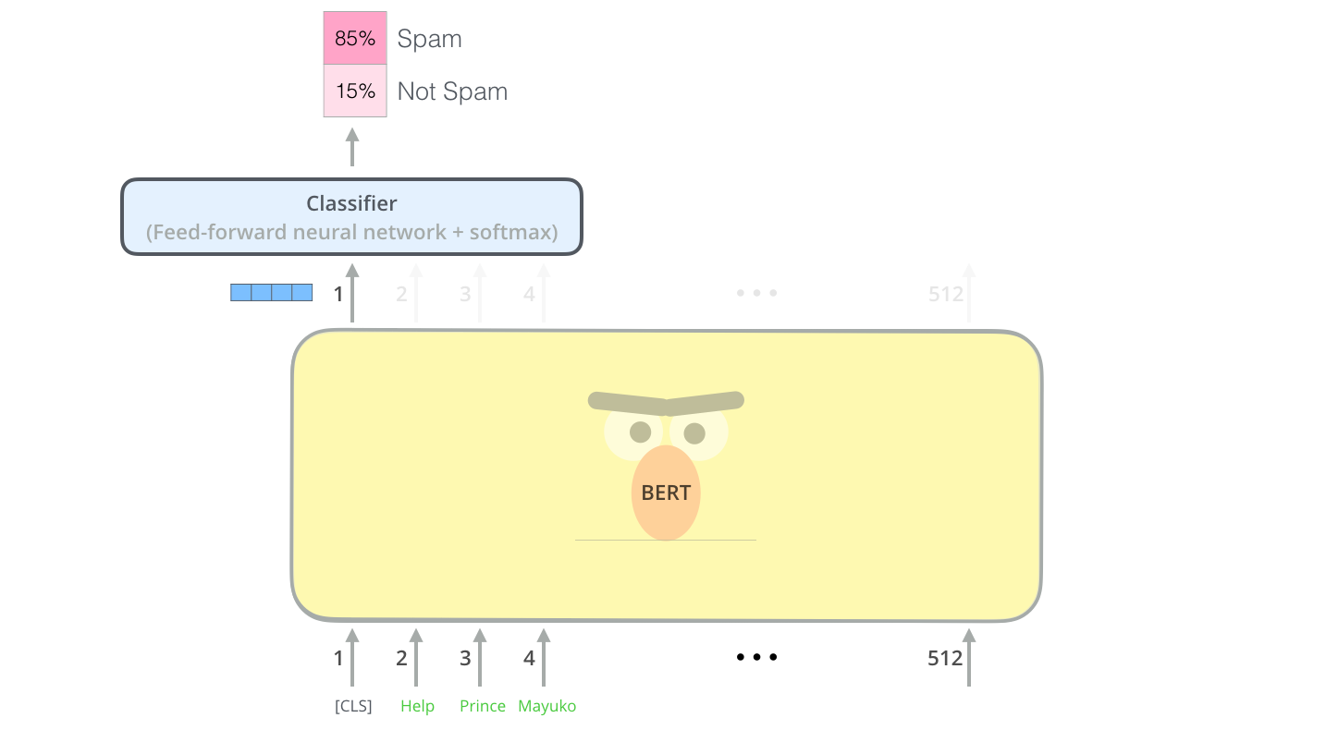
BERT: A special [CLS] token is used for classification

Slide 20
BERT: Two-sentence Tasks
The sentence pair contains 2 sentences, 50% of the sentence pairs are related sentences which appears in the document one by one, 50% of the sentence pairs are not related, which the sentence are combined randomly.
Useful for many NLP tasks like QA, entailment, inference etc

Slide 21
BERT: Two-sentence Tasks
Input = [CLS] the man went to [MASK] store [SEP] he bought a gallon [MASK] milk [SEP]
In this case the sentences are adjacent, so the label in [CLS] would be ‘<IsNext>’ as in:
Input = <IsNext> the man went to [MASK] store [SEP] he bought a gallon [MASK] milk [SEP]

Slide 22
BERT: Two-sentence Tasks
The loss was calculated as the sum of the mean masked LM likelihood and the mean next sentence prediction likelihood.

Slide 23
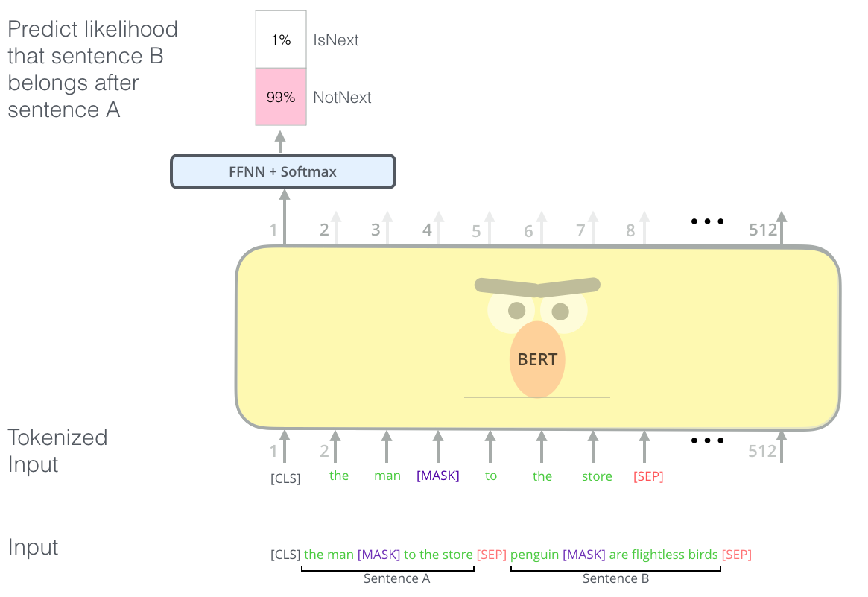

Slide 24
Segmentation Embedding
E.g. token sentence:
‘[CLS] I have a dream [SEP] The cat is white [SEP]’,
segmentation embedding: [0,0,0,0,0,1,1,1,1,1]

Slide 25
Mask word embedding
0 represents normal word, 1 represents mask word.

Slide 26
Out of vocabulary words
BERT Tokenization: WordPiece model

Slide 27
BERT Tokenization: WordPiece model
This model greedily creates a fixed-size vocabulary of individual characters, subwords, and words that best fits our language data. Since the vocabulary limit size of BERT tokenizer model is 30,000, the WordPiece model generated a vocabulary that contains all English characters plus the ~30,000 most common words and subwords found in the English

Slide 28
BERT Tokenization: WordPiece model
Whole words
Subwords occuring at the front of a word or in isolation.
Subwords not at the front of a word, which are preceded by ‘##’ to denote this case
Individual characters
The word “embeddings” is represented:
[‘em’, ‘##bed’, ‘##ding’, ‘##s’]

Slide 29
BERT Tokenization: WordPiece model
Rather than assigning out of vocabulary words to a catch-all token like ‘OOV’ or ‘UNK,’ words that are not in the vocabulary are decomposed into subword and character tokens that we can then generate embeddings for.

Slide 30
Context Based Similarity
“After stealing money from the bank vault, the bank robber was seen fishing on the Mississippi river bank.”
First 5 vector values for each instance of "bank".
bank vault tensor([ 3.3596, -2.9805, -1.5421, 0.7065, 2.0031])
bank robber tensor([ 2.7359, -2.5577, -1.3094, 0.6797, 1.6633])
river bank tensor([ 1.5266, -0.8895, -0.5152, -0.9298, 2.8334])

Slide 31
Context Based Similarity
Similarity of ‘bank’ as in ‘bank robber’ to ‘bank’ as in ‘river bank’
Cosine similarity = 0.67
Similarity of ‘bank’ as in ‘bank robber’ to ‘bank’ as in ‘bank vault’
Cosine similarity = 0.9

Slide 32
How to use pretrained model
Fine Tune
Feature based

Slide 33
BERT as Fine Tuned Model
Add a classifier (like softmax layer) after the pretrianed model, then use downstream task data to learn new layer’s weights and slightly change the weights of pretrained model with back propagation
Pros: when we don’t have enough labeled data for training, with transfer learning by pretrained model ,we can somehow increase our training model accuracy with little training data.
Cons: Task’s input embedding must be the same as the pretrained task, also, the task between downstream and pretrained task can not be too different, otherwise, what model have learned form pretrained task cannot apply to new task.

Slide 34
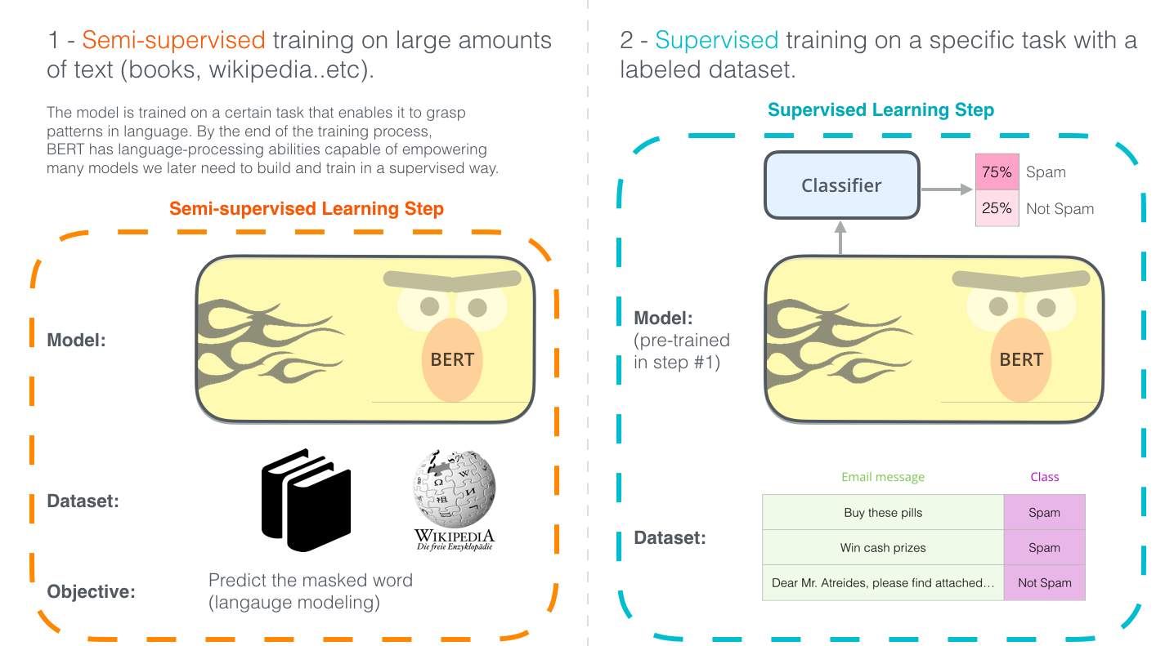

Slide 35
BERT as Feature Extraction Model
Just like what W2V, we treat the pretrained result as a feature embedding for our downstream task, then we will use our full defined model(like: LSTM) to learn some abstract mapping knowledge from the embedding .
Pros: when we get enough learning data, its ok to learn from pretrained embedding, we have little restrict from pretrained model ,since it just act like an input for the whole model
Cons: we need to learn the model from scratch, and our model can be only used for only one task

Slide 36
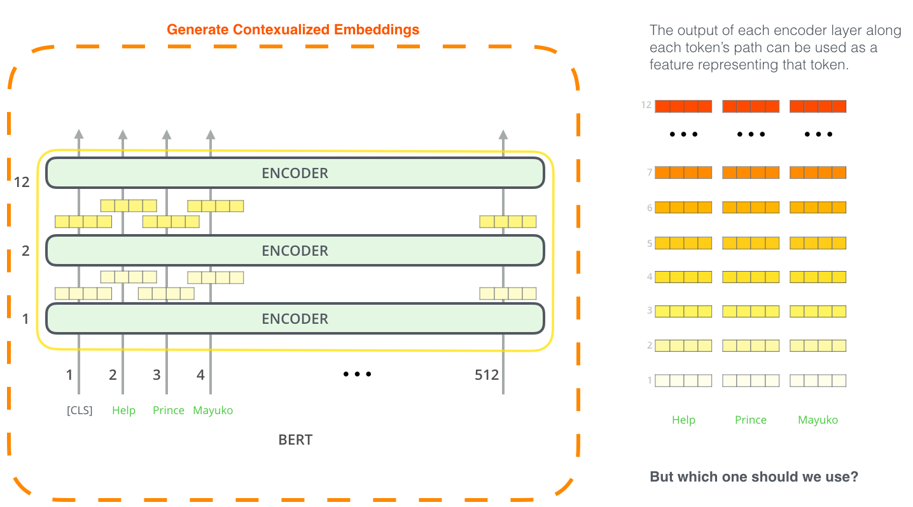
BERT: For Feature Extraction

Slide 37
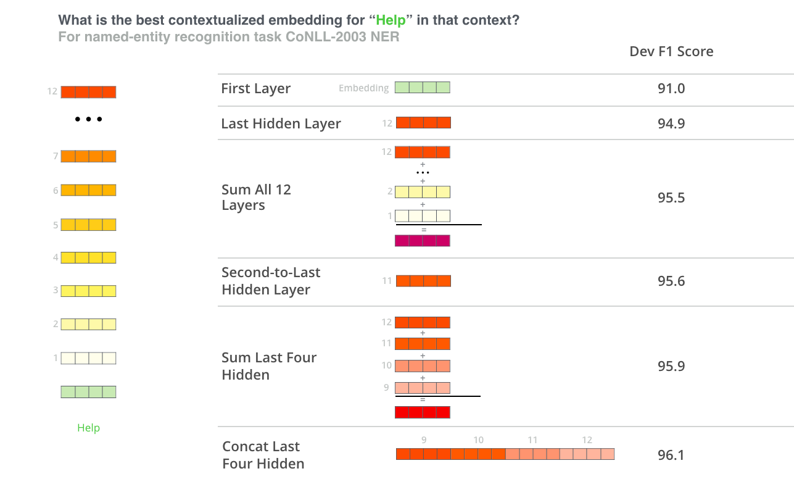

Slide 38
BERT: Multihead Redundancy
The following paper has description of the regularization term added to the loss for ensuring that different attention heads learn different distributions. The regularization term makes sure attention distributions are different and focus on only few items.
A STRUCTURED SELF-ATTENTIVE SENTENCE EMBEDDING (https://arxiv.org/pdf/1703.03130.pdf)
The following paper has visualization examples of different BERT attention heads paying attention to different words.
What Does BERT Look At?An Analysis of BERT’s Attention (https://nlp.stanford.edu/pubs/clark2019what.pdf)

Slide 39
References
Jacob Devlin, Ming-Wei Chang, Kenton Lee, Kristina Toutanova, BERT: Pre-training of Deep Bidirectional Transformers for Language Understanding, Proceedings of the 2019 Conference of the North American Chapter of the Association for Computational Linguistics: Human Language Technologies, Volume 1
http://jalammar.github.io/illustrated-bert/
https://medium.com/dissecting-bert/dissecting-bert-part2-335ff2ed9c73
https://billpku.github.io/2019/04/20/BERT%20in%20theory/#About-BERT-masked-LM-task
https://mccormickml.com/2019/05/14/BERT-word-embeddings-tutorial/

